Slide 1
Capstone Engagement
Assessment, Analysis, and Hardening of a Vulnerable System
Created by : Chaitanya Sugathan

Slide 2
Table of Contents
This document contains the following sections:
01
Network Topology
02
Red Team: Security Assessment
03
Blue Team: Log Analysis and Attack Characterization
Hardening: Proposed Alarms and Mitigation Strategies
04
Created by : Chaitanya Sugathan

Slide 3
Network Topology
‹#›

Slide 4
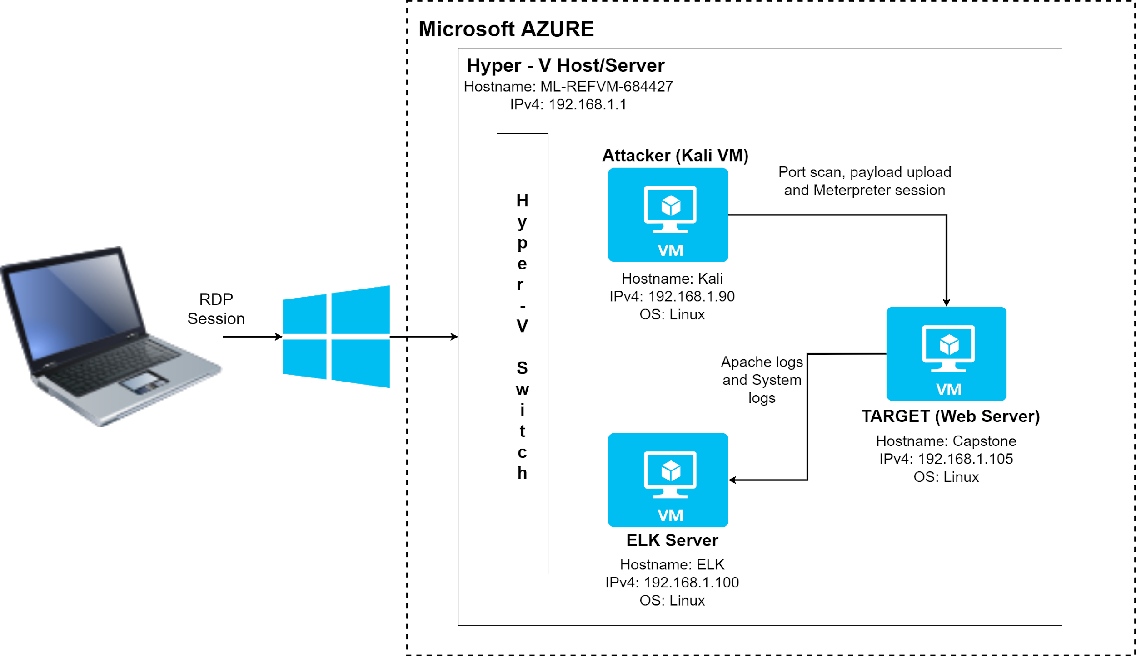
Network Topology
Network
Address Range:
192.168.1.0 - 192.168.1.255
Netmask: 255.255.255.0
Gateway: 192.168.1.1
Machines
IPv4: 192.168.1.1
OS: Windows
Hostname: ML-REFVM-684427
IPv4: 192.168.1.90
OS: Linux
Hostname: Kali
IPv4: 192.168.1.100
OS: Linux
Hostname: ELK
IPv4: 192.168.1.105
OS: Linux
Hostname: Capstone
Created by : Chaitanya Sugathan

Slide 5

Red Team
Security Assessment
Created by : Chaitanya Sugathan
‹#›

Slide 6
Recon: Describing the Target
Nmap identified the following hosts on the network:
Hostname | IP Address | Role on Network
Hostname: ML-REFVM-684427 OS: Windows | IPv4: 192.168.1.1 | HyperV-host. Hyper-V implements isolation of virtual machines in terms of a partition.
Hostname: Kali OS: Linux | IPv4: 192.168.1.90 | Hacker (Penetration Tester): Virtual machine installed with Kali Linux used for penetration testing, ethical hacking and network security assessments
Hostname: ELK OS: Linux | IPv4: 192.168.1.100 | SIEM: Elasticsearch, Logstash, and Kibana for analytics and log analysis
Hostname: Capstone OS: Linux | IPv4: 192.168.1.105 | Target (Web Server): Linux Virtual machine, which hosts the webdav, is the machine which we are trying to penetrate and expose vulnerabilities on.
Created by : Chaitanya Sugathan

Slide 7
Vulnerability Assessment
The assessment uncovered the following critical vulnerabilities in the target:
Vulnerability | Description | Impact
Directory Browsing Vulnerability | Directory browsing is enabled on a web server | The attacker was able to access the various directories, sub directories and files on the Target server
Brute Force Vulnerability | A vulnerability which allows a brute-force attack to determine the credentials | The password for Ashton’s User Id was found out successfully and used to access the secret_folder
WebDav Vulnerability | WebDAV is an extension to the HTTP protocol. It allows authorized users to remotely add and change content on your web server. | Attacker was able to access the webdav directory on the Target from the local File manager tool and upload the php reverse shell payload
Remote command execution vulnerability | Attackers can use a reverse shell to obtain an interactive shell session on the target machine | Attackers was able to use the remote shell to gain control of the Target and execute commands successfully to penetrate deeper into the system
Created by : Chaitanya Sugathan
Notes:
REFERENCES:
https://resources.infosecinstitute.com/topic/mitre-attck-vulnerability-spotlight-brute-force/
https://www.toxicsolutions.net/2020/07/lfi-to-shell/
https://www.amirootyet.com/post/directory-browsing-vulnerability/
https://www.netsparker.com/blog/web-security/understanding-reverse-shells/

Slide 8
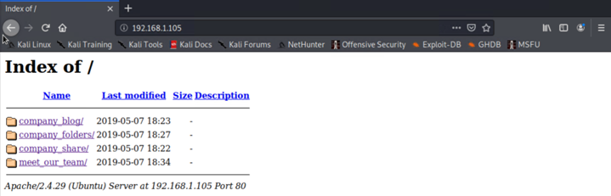
Exploitation: Directory Browsing Vulnerability
01
Tools & Processes
The port scan using nmap showed that the port 80 was open on the Target web server.
On Firefox web browser, provide the url: http://192.168.1.105/
02
Achievements
The attacker is able to view all the folders and files present on the web directory. If the attacker is dedicated enough, he will read these files contents and codes to figure out a way to circumvent security
03
Created by : Chaitanya Sugathan

Slide 9
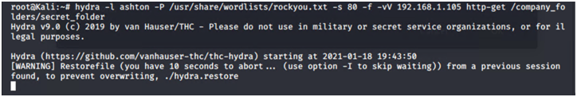
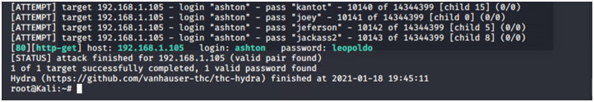
Exploitation: Brute Force Vulnerability
01
Tools & Processes
Brute force attack was performed using Hydra software.
Inputs provided to hydra command:
The User Id found by directory traversal
rockyou.txt file used as the wordlist.
02
Achievements
The brute force attack was able to figure out the password for the user id, which was then used to access the secret_folder directory on the file system of the web server.
03
Command used: hydra -l ashton -P /usr/share/wordists/rockyou.txt -s 80 -f -vV 192.168.1.105 http-get /company_folders/secret_folder
Created by : Chaitanya Sugathan

Slide 10
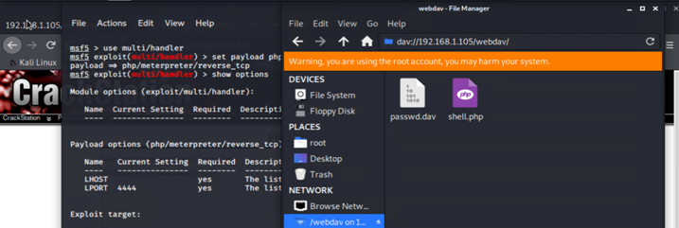
Exploitation: WebDav Vulnerability
01
Tools & Processes
The local file system manager tool was used to access the Webdav directory on the remote directory and upload the php shell.
02
Achievements
msfvenom was used to generate a php reverse shell payload which was then moved to the webdav subdirectory using the file system manager.
03
Created by : Chaitanya Sugathan

Slide 11
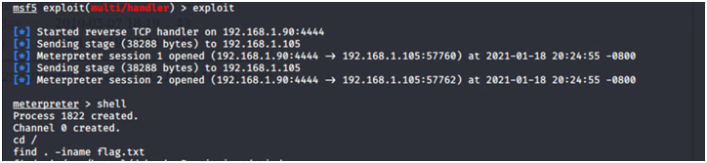
Exploitation: Remote command execution vulnerability
01
Tools & Processes
A php reverse shell payload was used to establish a reverse shell connection.
Msfvenom -> To create the reverse shell tcp payload
Meterpreter -> Establish reverse shell listener and establish connection
02
Achievements
The attacker was able to establish a remote connection to the Target machine and execute commands
03
Created by : Chaitanya Sugathan

Slide 12

Blue Team
Log Analysis and Attack Characterization
‹#›

Slide 13
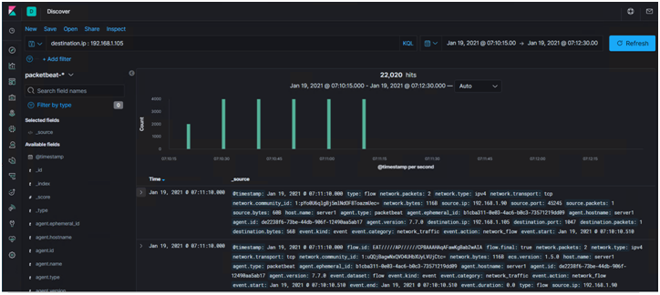

Analysis: Identifying the Port Scan
What time did the port scan occur? - Jan 19, 2021 @ 07:10:15 - Jan 19, 2021 @ 07:11:15
How many packets were sent, and from which IP? - There was 22,020 hits from IP 192.168.1.90
What indicates that this was a port scan? - The hits were made to multiple ports; the source packet and destination packets were each 1 indicating that it was the attacker probing to find which ports on destination IP 192.168.1.105 were open.
Created by : Chaitanya Sugathan

Slide 14
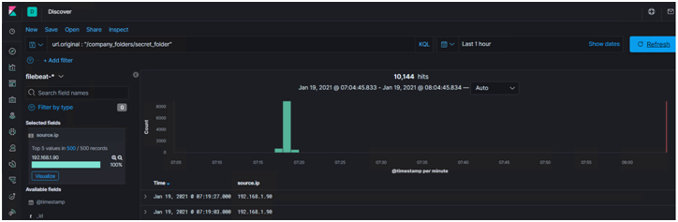
Analysis: Finding the Request for the Hidden Directory
What time did the request occur? How many requests were made?
The requests were made on Jan 19, 2021 between 7:17:00 - 7:19:00
A total of 10,144 hits were logged as accessing the url path of the secret_folder (hidden folder)
Created by : Chaitanya Sugathan

Slide 15
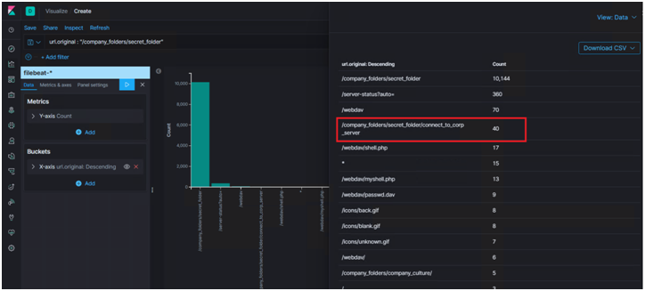
Analysis: Finding the Request for the Hidden Directory (contd.. )
Which files were requested? What did they contain?
- The file requested was connect_to_corp_server
- This file contained Ryan’s password in hashed format.
- This file also contained instructions on how to access the webdav directory and add new files
Created by : Chaitanya Sugathan

Slide 16
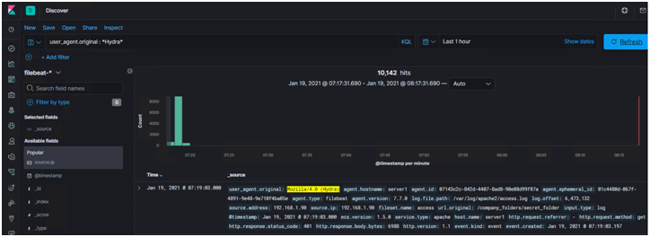
Analysis: Uncovering the Brute Force Attack
How many requests were made in the attack?
- 10,142 hits were made in total as part of the brute force attack
Created by : Chaitanya Sugathan

Slide 17
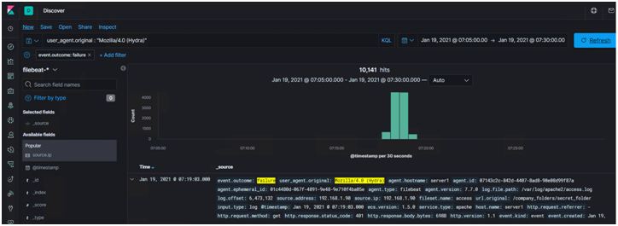
Analysis: Uncovering the Brute Force Attack (contd.. )
FAILURE COUNT
How many requests had been made before the attacker discovered the password?
10,141 hits were made before the attacker discovered the password
Created by : Chaitanya Sugathan

Slide 18
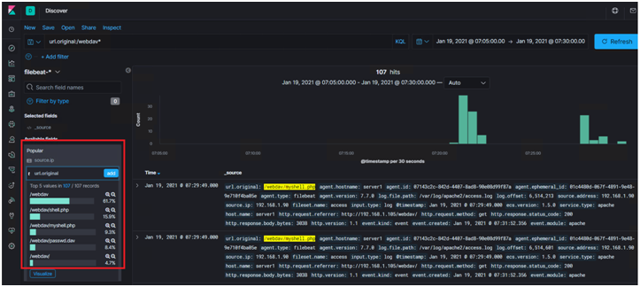
Analysis: Finding the WebDAV Connection
How many requests were made to this directory?
- 107 requests were made to this directory
Which files were requested?
- Files requested were : shell.php, myshell.php (copy of shell.php) and passwd.dav
Created by : Chaitanya Sugathan

Slide 19
Blue Team
Proposed Alarms and Mitigation Strategies
‹#›

Slide 20
Mitigation: Blocking the Port Scan
Alarm can be configured to monitor for simple thresholds and patterns, such as number of ports connected to from a single origin over a period of time
A threshold of 20 connections per second can be set at IP level. The alarm is activated once the threshold is crossed. This alert will be activated even if the connections are over a range of port numbers.
All the ports are closed by default. Only the ports which need to accept traffic are then opened, subject to requirement.
IDS or IPS systems are integrated with the network to detect the port scans (and take action).
Firewall rules are configured to route traffic from a malicious source to ‘honey pots’ or empty hosts. These rules get triggered when alarm is set-off (and the malicious IP has been identified).
Created by : Chaitanya Sugathan

Slide 21
Mitigation: Finding the Request for the Hidden Directory
Alarms can be configured to detect unauthorized access to the hidden directory (url.original:<hidden directory path>)
All attempts to access from outside the network should be detected and flagged
Since the directory contains sensitive information, the alarm threshold will be 1 attempt to access the directory.
Ensure that the directory traversal is blocked from the web browser.
Ensure that complex passwords are used, which are hard to crack using brute force attack tools.
Try to avoid storing sensitive files on the web server, rather use file vaults or secure document repositories to store such documents
Created by : Chaitanya Sugathan

Slide 22
Mitigation: Preventing Brute Force Attacks
Configure alarms to detect Authentication/Authorization failures (HTTP status code 401)
Configure alarms to detect requests from known brute force attack tools
The threshold value to generate alerts can be 10. This value can be reduced based on the sensitive nature of the resource being accessed.
Setup account lockouts on 3 or more incorrect passwords
The lockout duration can be incremental based on the number of attempts - Example for first 3 attempts, account gets locked for 30 mins. Next time the lockout duration is incremented to 60 minutes and so on.
Have password policies in place to
Set complex passwords
Change passwords frequently
Prevent re-using old passwords
Created by : Chaitanya Sugathan

Slide 23
Mitigation: Detecting the WebDAV Connection
Configure an alarm which will monitor the access on the WebDav directory from outside the network.
Threshold should be 1 attempt from outside the network.
Because of its added complexity, it is considered good practice to disable WebDAV if it is not currently in use.
Secure port 80, preventing access to url path for webdav access.
Update the softwares to the latest versions and ensure all security patches have been applied
Created by : Chaitanya Sugathan
Notes:
Note: WebDAV is a set of extensions to the HTTP protocol that allows users to collaboratively edit and manage files on remote web servers. Many web servers enable WebDAV extensions by default, even when they are not needed.
WebDAV uses port 80, the same port used by HTTP for web access

Slide 24
Mitigation: Identifying Reverse Shell Uploads
Configure alarm to monitor file being uploaded to the server from a source outside the network.
Check for file patterns and extensions to check for malicious executables files - like .exe or .php
Check for signatures of previously known shells
Detect anomalous web traffic patterns
The threshold limit can be upto 1 attempt.
Block upload of executable files which may be malicious in nature.
Block access to used services and ports
Install security products which will detect malicious executable files and shells
Monitoring file integrity
Created by : Chaitanya Sugathan
Notes:
https://resources.infosecinstitute.com/topic/how-to-detect-and-prevent-web-shells-new-guidance-from-the-nsa-and-the-australian-government/
If you are not able to harden web application permissions, you can get a similar effect by monitoring file integrity. This is because file integrity solutions can allow you to block or alert you when changes to web accessible directories occur. Depending on your file integrity monitoring solution, you may be able to allow certain legitimate file changes and deny others.

